Slide 1
CSCI 45 Computer Organization
Professor William Kerney

Slide 2

4K Video

Slide 3
Agenda
Syllabus Review
Grading
Extra Credit Opportunities
Course Topics for this year:
Computer Architecture
Physical Computing
Learning Assembly Programming

Slide 4
Syllabus Review
Review policies and procedures yay
NOTE: Our server this year will be on rpi.csci4x.com, not www.csci4x.com, as you may be used to.
It’s a super-powerful $35 computer that will be hosting all of your school work.
So treat it nicely, eh?
The most important bit, grading:
20% Midterm I (week 6)
20% Midterm II (week 12)
20% Final Exam
20% Individual Homework
20% Group Projects

Slide 5
Extra Crédit
One of the things I most enjoy about teaching is coming up with fun ways of offering extra credit.
What I care about is you all walking away from my class knowing the material at 100%, and able to use it.
Also, don’t shame this institution when you transfer.
Especially UCSD, because that would be embarrassing.
So if your grades aren’t doing well, appeal to me to do extra work, and unless it’s after the final, I’ll tend to come up with something fun and educational.
Note: All extra credit projects are made available to all students.

Slide 6
Group Extra Crédit
The class will be divided into four groups, based on where you are sitting right now.
Front right will be called “Slytherin”
Front left will be called “Ravenclaw”
Back right will be called “Hufflepuff”
Back left will be called “Gryffindor”
I will move students around if people drop.
If you do something to impress me, either by answering a question or finding a mistake in my work or any other act of academic awesomeness, I’ll award group bonus points.
At the end of the semester, 10% of extra crédit will be given out, proportionally to the amount of points earned.

Slide 7
Group Extra Crédit
Suppose at the end of the semester, Griffindor has 100 points, Slytherin has 200 points, Hufflepuff has 50 points, and Ravenclaw has 250 points.
Total points = 500
All students in Griffindor get 100/(total points) = +1.5%
All Slytherin get 200/(total points) = +3.2%
Hufflepuffers get 50/(total points) = +0.8%
And overachieving Ravenclaw gets +4.15%
+10 points to Ravenclaw for finding the error. Thanks, Ben.

Slide 8
Group Extra Crédit
The first option for group extra credit will be for each group to create a web site to track these point totals.
No this isn’t a web class, you’ll need to figure it out on your own.
Details:
It needs to be hostable from www.csci4x.com, which means only Apache, PHP, MySQL are available server-side.
It needs to log all transactions publicly, so all students can audit it and see that Mason is not giving extra points to Slytherin.
It should be big, colorful, and easy to quickly add or remove points from the individual schools.
The running total should be displayed at all times, including which percentage of the total points each group has.
It is worth 50 points to your group, due in one week. If I accept your group’s project over the others, it’s another 50 points.

Slide 9
Overview for the Semester
We’re going to be learning three main things in this class:
Computer Architecture
What it is, how they compare and all that.
Physical Computing
Connecting computers to the real world.
Assembly Programming
The Hows and Whys of assembly.

Slide 10
Computer Architecture
Computer Architecture means “How a computer is put together.” Sometimes called microarchitecture or µarch.
Not the “I bought a new NVIDIA video card and am swapping it in” level, but at the level of “The ARMv7 architecture supports only an L1 cache, whereas x86_64 systems typically have three tiers of caching before RAM.”
All those weird stats on those cards at Best Buy? You’ll get to understand them. And why they make a real difference.
So what you’ll get out of this class is that the big question mark over what’s really going on inside a computer will be removed. Even though you’re “computer people”, much of it should still be a mystery to you...

Slide 11
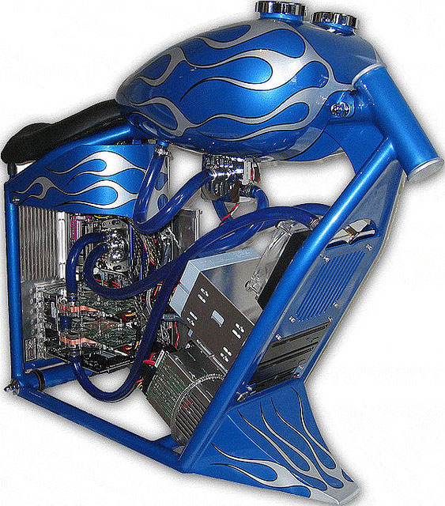

Me, At Your Level....

Slide 12
Benefits
Understanding how a computer actually works at a low level is beneficial to pretty much everyone...
Sysadmins / IT guys
Low level programmers (assembly folks)
High level programming (C++, Java)
Script programmers (ECMAScript)
Gamers looking to make a sweet rig
People buying a new computer who don’t want to get ripped off because they are told they need an i7 K-series to check email.

Slide 13
But wait – there’s more!
Included for free in our architecture classes:
Learning binary, octal, hex, and decimal numbers
2’s compliment
Circuit design
Simple component design
And much much more

Slide 14
Physical Computing
We have bought Raspberry Pi’s for all of you.
They will be coming in the end of January, so we’re going to put off this component until then.
But we’ll be doing cool stuff combining sensors and motors and lights to do projects that connect computers to the real world.
I plan on this class being very hands-on with applications.
We’ll touch a little bit on circuits.

Slide 15
Assembly Programming
This semester we’ll be programming in assembly. (ASM)
Unlike C/C++, ASM is NOT one programming language.
Every CPU manufacturer puts together an assembly language for programming their chips. So Intel x86 assembly is different from ARM (which is what we’re going to be programming in), which is different from Thumb, Motorola 68K, SPARC and MIPS (four other assembly languages I know my goodness that’s a lot).
But once you get the hang of one assembly language, it’s easy to learn the others quickly. The challenge to learning ASM is just the new mindset it requires.

Slide 16
Why?
Even today with us living in the future with our hoverboards and such, we still need to learn assembly:
Optimization (most common use)
Embedded systems (a.out AS vs C: 664 vs. 5307 bytes)
Helps you to learn Computer Architecture
Operating Systems / Device Drivers
Compilers generate assembly.
You can do many things in ASM you can’t do in C++
Reverse Engineering
Artists making demos (multimedia apps < 1k/4k/64k/256M)

Slide 17
So... what does assembly look like?
Here’s the code in C in a file called test.c:
int main() {
int x = 42;
int y = 21;
return x + y;
}
You can view the result from the UNIX prompt after compiling it (via gcc test.c) and running it (via typing a.out) by typing: echo #?

Slide 18
So... what does assembly look like?
Don’t panic if you don’t understand what you’re about to see. The point is to just show you what various assembly languages look like.
Every assembly language works mainly with “variables” called registers. Registers are actual spots on a CPU where values can be held and manipulated quickly.
In general, since the code is setting two variables, look for a MOVE (or MOV or MOVL) command in each of the variants, which is used to move a value from one place to another, for example: “mov r3, #42” puts the value of 42 into register #3.
Look for add commands to add 42 and 21 together.

Slide 19


Slide 20
ARM Assembly
Here’s the code in handcrafted ARM assembly (test.s):
.global main
main:
mov r2, #42
mov r1, #21
add r0, r1, r2
bx lr
You compile it (gcc test.s) and run it (a.out) exactly the same way, except it’s a .s file instead of a .c file. Do an echo $? after running it, and check that it’s identical.

Slide 21
Here’s gcc’s first attempt at the same code in assembly
.global main
main:
str fp, [sp, #-4]!
add fp, sp, #0
sub sp, sp, #12
mov r3, #42
str r3, [fp, #-8]
mov r3, #21
str r3, [fp, #-12]
ldr r2, [fp, #-8]
ldr r3, [fp, #-12]
add r3, r2, r3
mov r0, r3
add sp, fp, #0
ldmfd sp!, {fp}
bx lr

Slide 22
Here’s gcc with optimization turned on
.global main
main:
mov r0, #63
bx lr
...cheater.
The point was to show you how to do a simple addition of two variables.

Slide 23
x86 Assembly (also by gcc)
.globl main
main:
pushl %ebp
movl %esp, %ebp
subl $16, %esp
movl $42, -8(%ebp)
movl $21, -4(%ebp)
movl -4(%ebp), %eax
movl -8(%ebp), %edx
addl %edx, %eax
leave
ret

Slide 24
68K assembly
Something like this (I’m a bit rusty):
START ORG $1000
MOVE #42,D0
MOVE #21,D1
ADD D1,D0
END START

Slide 25
Instruction Set Architectures
Each assembly language represents a specific “Instruction Set Architecture”, or ISA.
This doesn’t mean a specific CPU or model, but rather a whole family of chips that will read the same kind of instructions. x86, 68K, PPC, ARM, MIPS, Alpha, POWER...
Interfaces are forever!
While commands might be added to an ISA over time (ARMv7 is a superset of ARMv6 which is a superset of ARMv5...) commands are basically never removed, as it would mean a new CPU would not be able to run programs compiled for earlier architectures.
So MAKE SURE YOU GET IT RIGHT THE FIRST TIME.

Slide 26
Homework 1 – ISA Me, Mario
Let’s invent a terrible ISA, and see what we can do!
We’ve got 4 registers to use: R0 through R3.
We’ve just got two commands in our ISA:
ADD: takes a register, followed by a register or a number
Example: ADD r0, r1 does r0 = r0+r1
Example: ADD r2, -r3 does r2 = r2-r3
Example: ADD r0, -1 subtracts 1 from r0
JGZ: if the register just written to is > 0, go back to the top of the program and keep running
Example: ADD r0, r1, followed by JGZ will jump back up to the top of the program if r0 is >= 0 after being added to by r1.
Example: ADD r0,-10 followed by JGZ will jump back to the top if r0 was 11 or higher before having 10 knocked off of it.

Slide 27
Homework 1 – Due Next Class
Puzzle 1: Implement multiplication on this system!
Input: R0 and R1 (positive ints). (R2 and R3 will start at 0.)
Output: At the end of your program, R0 must contain R0*R1. The state of the other registers doesn’t matter.
Puzzle 2: Implement modulus on this system!
Input: R0 and R1 (positive ints). (R2 and R3 will start at 0.)
Output: R0 must be set to R0 % R1. The state of the other registers doesn’t matter.
Puzzle 3: Copying register values
Input: R2 and R3. (R0 and R1 will start at 0.)
Output: R0 must equal R2’s original value, R1 must equal R3’s original value. R2 must equal 0, R3 must equal 0.

